Slide 1
AGI Customer Valuation
Segmentation and Analysis

Slide 2
Agenda
Project Objective
Data Description
Retention Rates - CORE
Customer Lifetime Value
Trial, Usage, and Other Useful Findings
Takeaways

Slide 3
Objective
“Our objective is to (1) determine the difference between and (2) assess the relative value of Desktop and Mobile users. We strive to provide insights into limits on acquisition costs by segment and how those limits may change throughout the calendar year.”

Slide 4
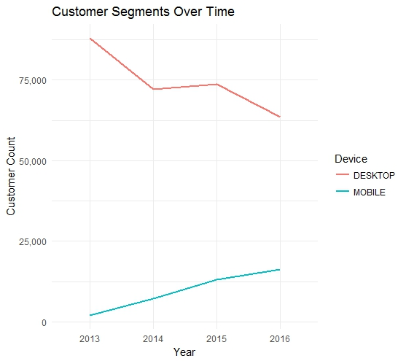
Data Overview
297,375 Desktop Users
38,670 Mobile Users
253,797 Trial Participants
4 Years of Data
16 Quarters
32 Segments

Slide 5
Customer Retention
Retention Rates…
impact CLV
are subject to bias
can change over time
are heterogeneous

Slide 6
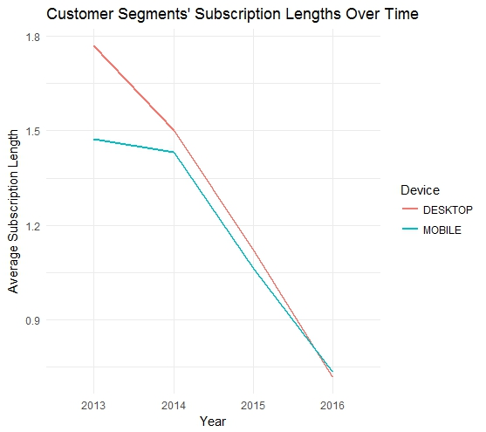
Customer Retention

Slide 7
Customer Retention
Without Temporal Segmentation…
subscriptions appear to shorten over time
retention can be biased
homogeneity is implied

Slide 8
CORE Analysis - Retention

Slide 9
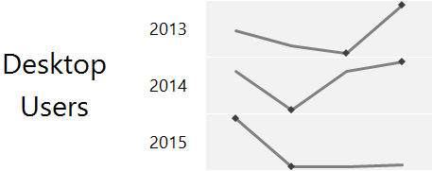
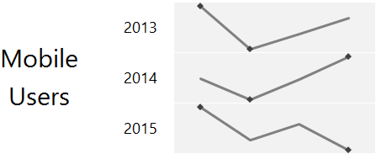
Retention Across Quarters
Seasonality…
Peak at Q1
Trough at Q2
Q4 ~ erratic

Slide 10
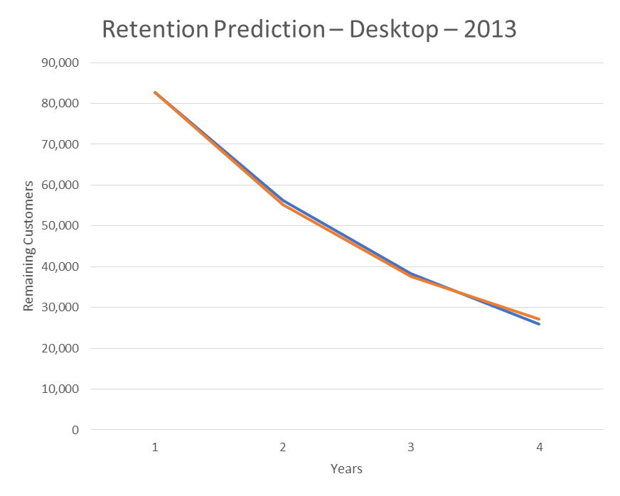
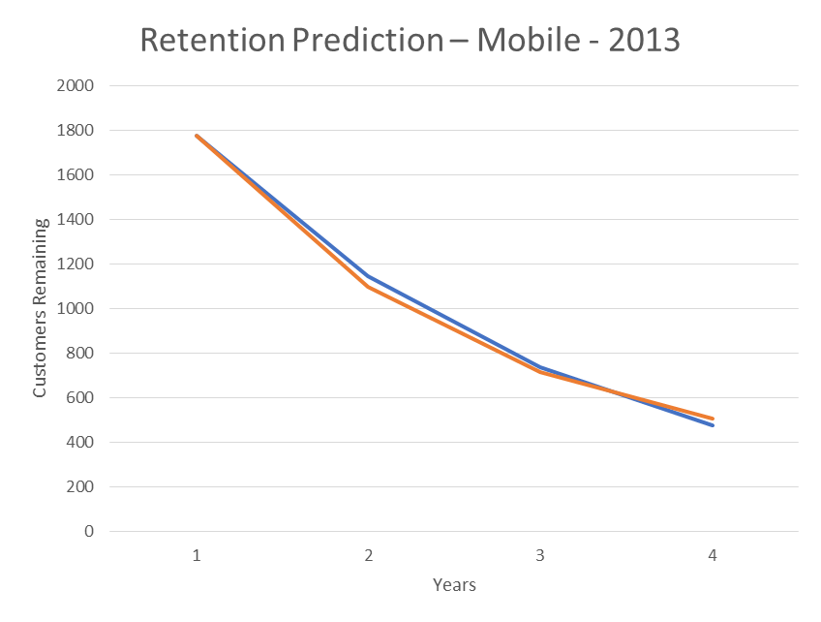
Modelling Retention

Slide 11
Modelling Retention
With enough data…
churn can be predicted
retention over time is revealed
heterogeneity is taken into account

Slide 12
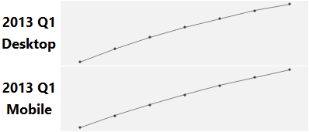
Retention Heterogeneity
Retention may change as low-loyalty users drop out
Estimates of CLV do not account for this idea
Included estimates are therefore conservative

Slide 13

CLV Measurement
$M per-period cash margin
r per-period retention rate
d per-period discount rate
Beta-Geometric Model
Subscription rate of $19.99
Discount rate between 7-13%
C_{M}/P_{M} < CLV_{M}
C_{D}/P_{D} < CLV_{D}
The mobile project deserves investment
The desktop project deserves investment

Slide 14
Customer Lifetime Value - Revenue

Slide 15
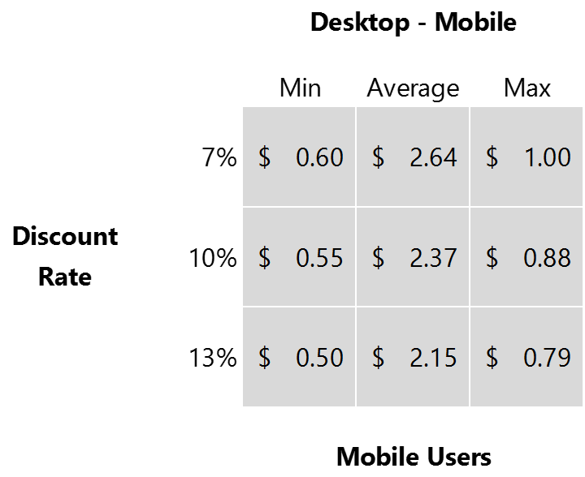
Difference – Desktop vs. Mobile
Desktop Users represent a higher customer value
Do they cost more to acquire?
Are they worth investing in?

Slide 16
Customer Lifetime Value - Margin

Slide 17
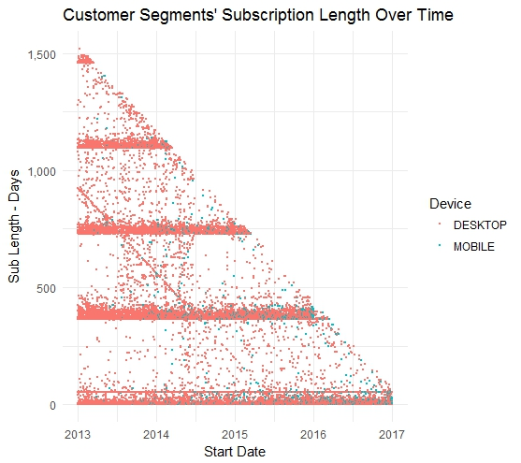
Subscription Lengths Over Time
Diagonal Lines – Point in Time
Horizontal Lines – Milestones
Population – Right Skewed

Slide 18
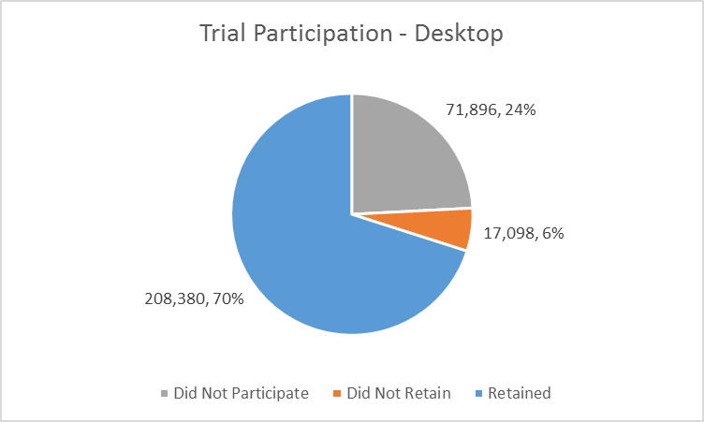
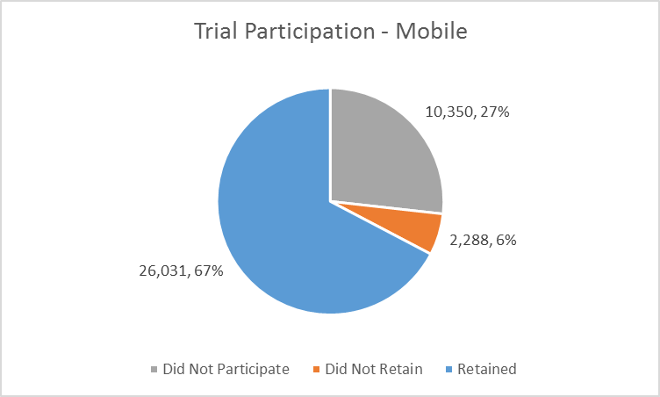
Trial Participation

Slide 19
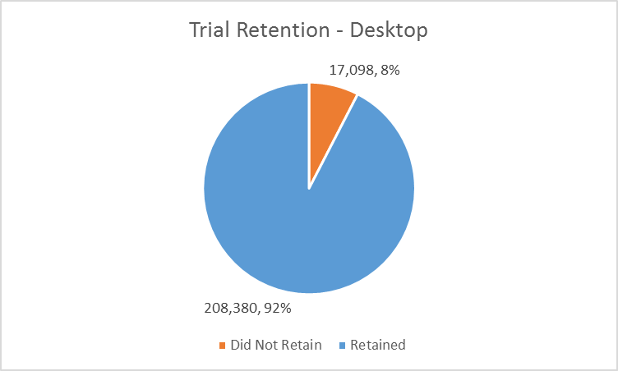
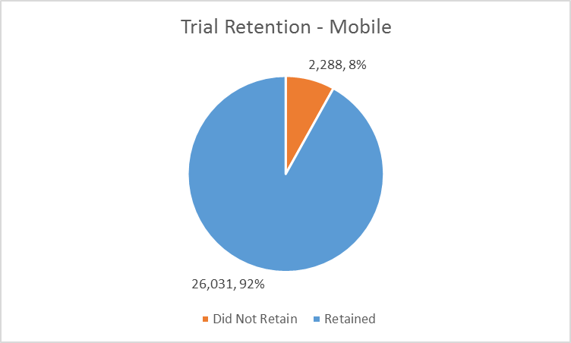
Trial Retention

Slide 20
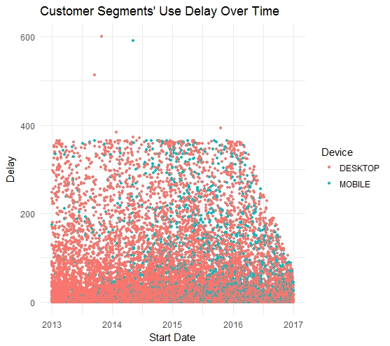
Delay Between Start and Use
99+ Percent who use within 1 year
5.2 Average days between start and use for Mobile users
2.9 Average days between start and use for Desktop users

Slide 21
Takeaways
Customer Acquisition
Desktop Customers…
have slightly higher value
could cost more to attain
Trends
Mobile Users…
are growing in number
could be a target market

